Slide 1

EDA LENDING CLUB CASE STUDY
- Anindita Das
- Ranveer Singh
- Submitted On : 08-06-2022

Slide 2



Agenda
1.Project Introduction
2. Charged Off vs loan_amnt
3. Charged Off' vs emp_length
4. Charged Off' vs annual_inc
5. Charged Off’ vs verification_status
6. Charged Off' vs home_ownership
7. Charged Off' vs purpose
8. BOXPLOT1: Charged Off' vs loan_amnt
9. BOXPLOT2: Charged Off' vs funded_amnt_inv
10.BOXPLOT3: Charged Off' vs installment
11. Correlation
12. HeatMap
13.Conclusion

Slide 3




Introduction Lending Club Case Study
Lending Club is a lending platform that lends money to people in need at an interest rate based on their credit history and other factors.The aim is to identify patterns which indicate if a person is likely to default, which may be used for taking → actions such as denying the loan, reducing the amount of loan, lending (to risky applicants) at a higher interest rate, etc.
In this case study, we will use EDA to understand how consumer attributes and loan attributes influence the tendency of default.First we upload excel/csv file and find different rows and coloums count/data etc. [*Mainly we’re analysising ‘loanDf’ excel here.

Slide 4

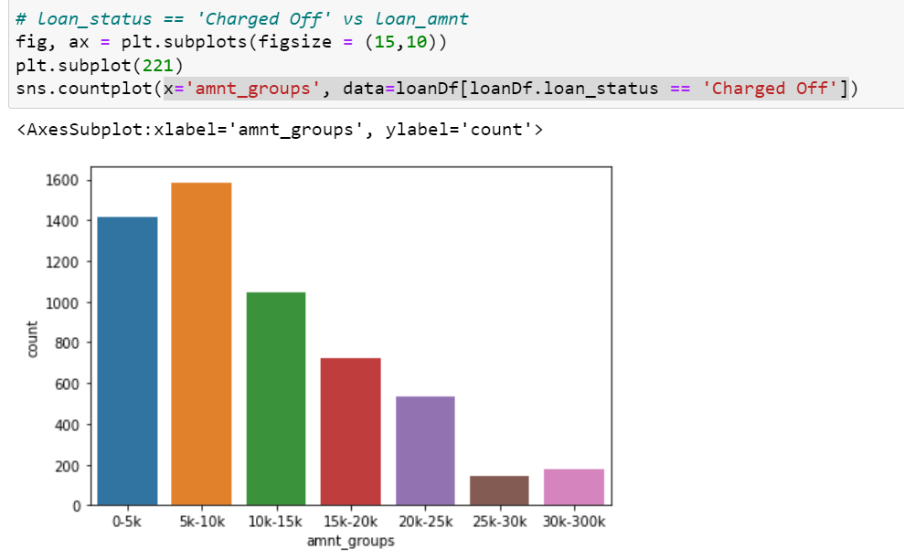
1. Charged Off' vs loan_amnt
Observation: 1. Count of charged_off has increased the loan_amount group also has decreased
2.Loan amount group range of 5k-10k is more number of credits and 25k-30k minimum number of credits.
3.Maximum charged off has not verified , RENT house and 36 month duration loans.
4Huge money loan has possibility to less charged off and less mone below 15k has high possibility to get charge off count. 15k is the repeated amount for charged off count.

Slide 5
2. Charged Off' vs emp_length Observation: > >It’s related emp_length and chrge off plot. We get maximum charge off count if emp_length is 10 or 10+ years and minimum possibility lies on 9 to 8 emp_length >> so when a loan is distributing for long time more than 10 years possibility to getting more charged off peoples. >> 50-50% probability is when you get money and get chanrge off peoples in the time duration between 4 to 6 years emp_length. >> We are getting the emp_length value in descending order until we get the value 10 or more than 10.

Slide 6
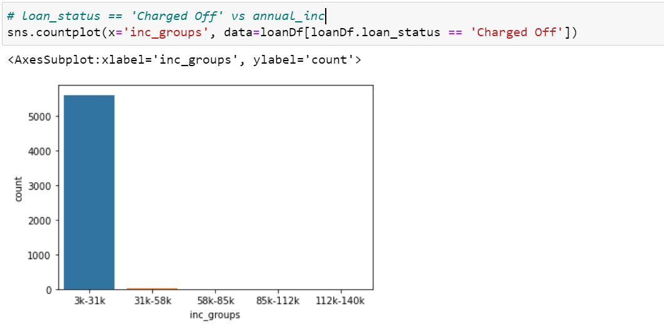
3. Charged Off' vs annual_inc * It’s related charge off possibility depends on annual income- It is huge possibilities to get charge off count increase when one person’s annual income 3000 to 31,000/- *Annual income with more than 31K and less than 3 k peoples are easy to close their loans positiviely. Hence club can give loan easily if annual loans has more than 31K.

Slide 7
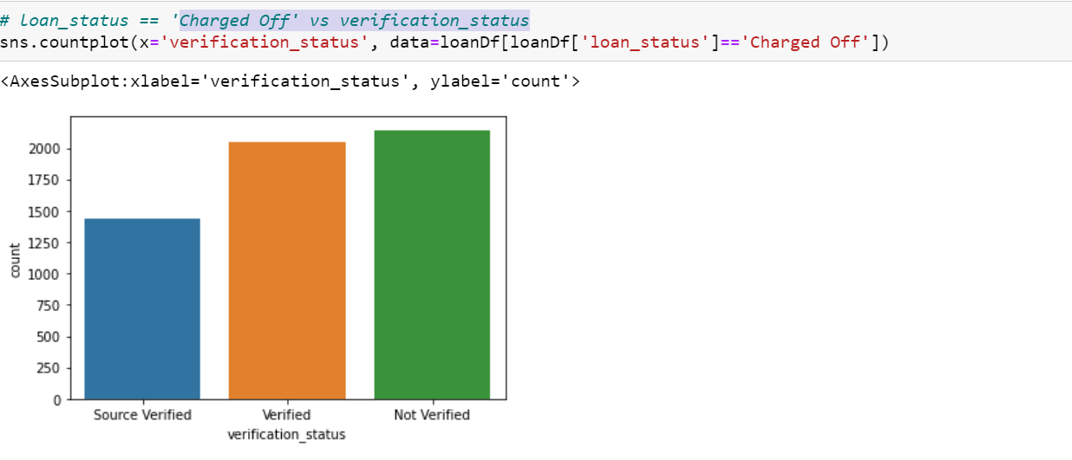

4. Charged Off' vs verification_status
Observation:
1)We observe there 3 kinds of verification status presents here. Like as - Source verification, verified verification, Non-verified verification.
2) According to plot where lack of verification situation presence means not verified loan doc or customer place there charge off possibilities is huge.
3)Mostly verified cases, almost people can able to complete there loans.Partially verified has partial possibility to get charge off .

Slide 8

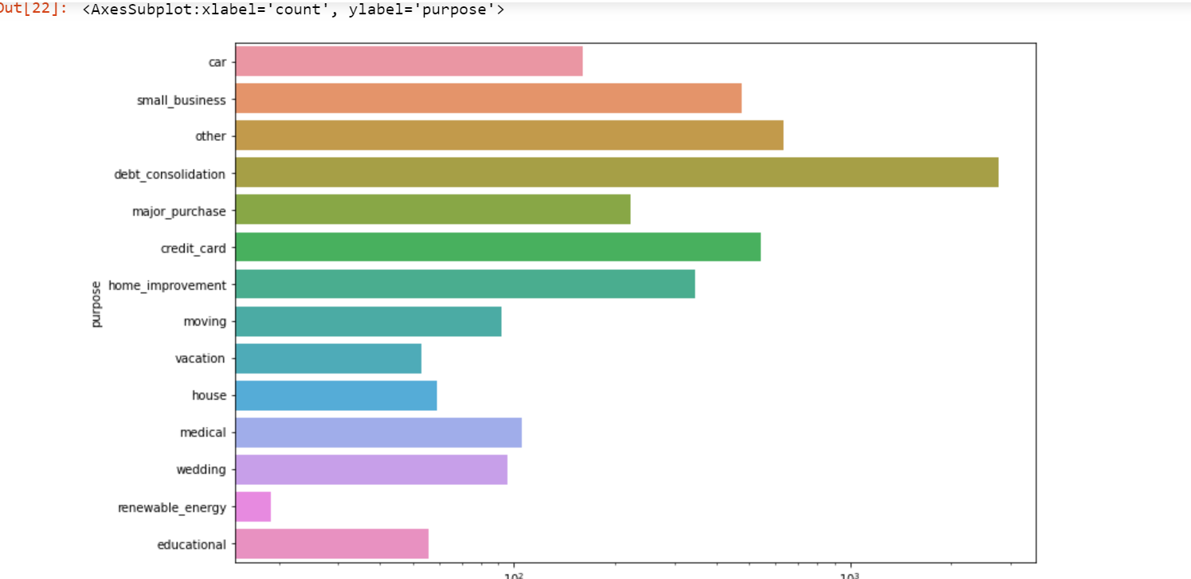


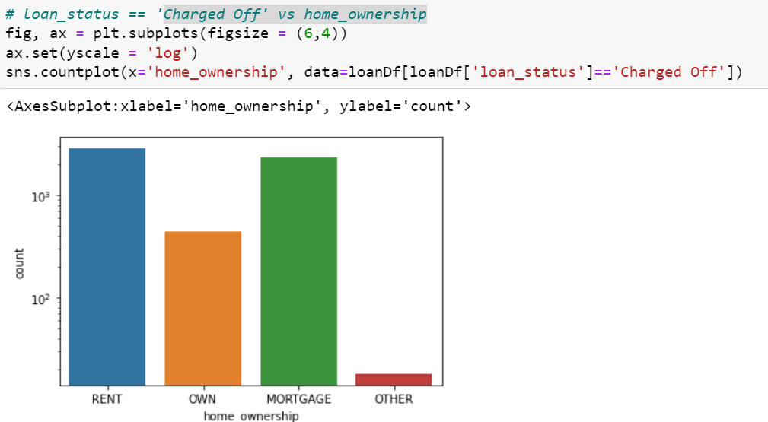
5. Charged Off' vs home_ownership
6. Charged Off' vs purpose
Title
Observation: 1. We can see that charge off possibility increase when home ownership status in ‘rent’ most or ‘Mortgage’.
2. So the loan pay back possibility increases when home ownership is others or own house.
3.So charge off possibilities always increase when not verified source exists or home in rent.
Observation: 1. Charge off possibilities increases with the purpose debt_consolidation and and get minimum with the purpose renewable energy .
2. Noted here Charge off possibility can come with the purposes debt_consolidation, other, credit card , small business.

Slide 9
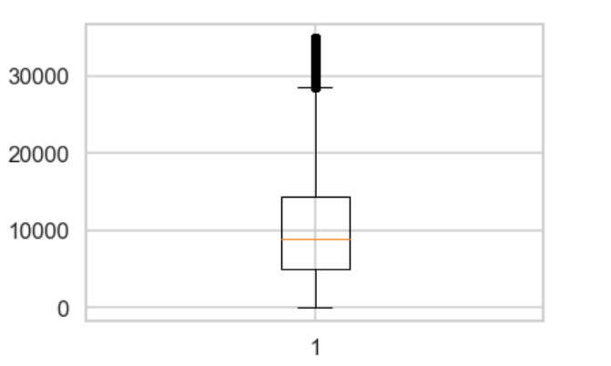
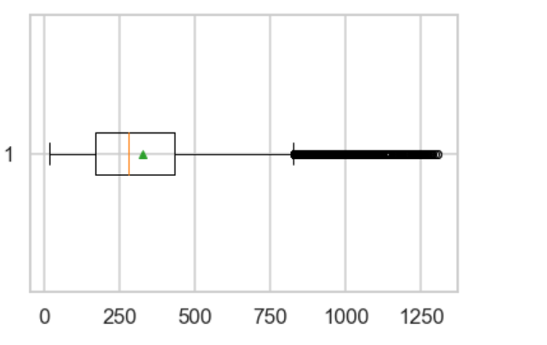
BOXPLOT: 1.charged off vs funded_amnt_inv boxplot 2. Charged Off' vs installment boxplot
.
Observation>> 1.Some outliers are noticed in funded_amount. 2.Most of the funded imcome is present in 3rd quartile, Median or average of funded amount exists in 3rd quartile
Observation>> 1. some ouliers are noticed in installment. 2. Most of the installment and average median of installments lies in 1st and 2nd quartile.

Slide 10
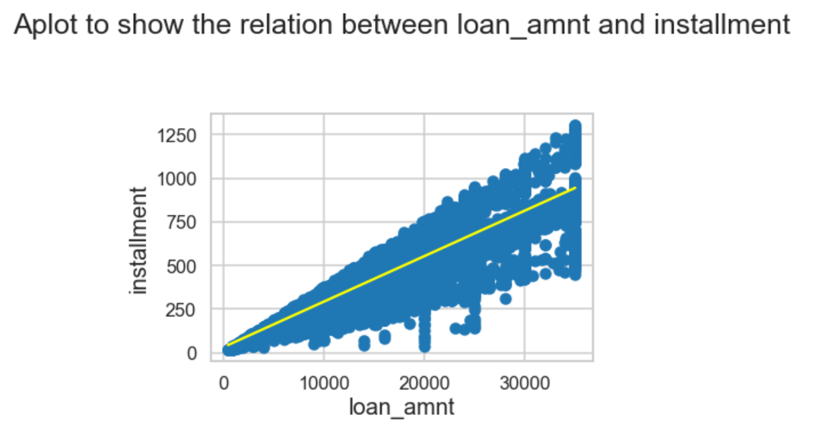
Correlation1 observation:
Observation:
1. Here is the correlation between loan_amount and installment. As the plot line going upside , it means installment and loan amnt co relation is good.
2. If loan amount increase in market then installment also increase proportionally in market.
Subtitle

Slide 11
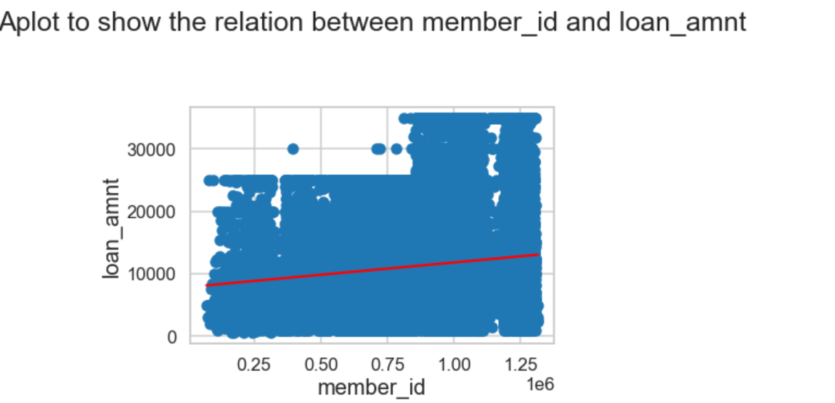
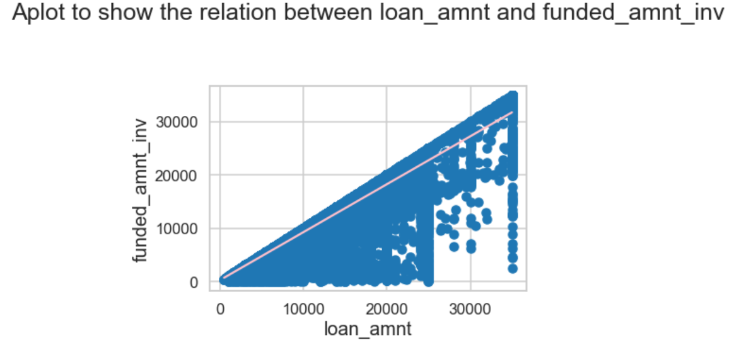
Correlation2 observation:
.Observation loan_amnt vs funded_amnt: As the plot is going upside it means loan amount and funded amount correlation is good and direct proportional to each other. If funded_amount decrease then loan amount will be also decreased and vice versa.
Observation loan amount vs member_id: here we can see almost stable straight line where member id denote member count . If loan amount increase then possibilities to member_id count increases in that datasheets.

Slide 12

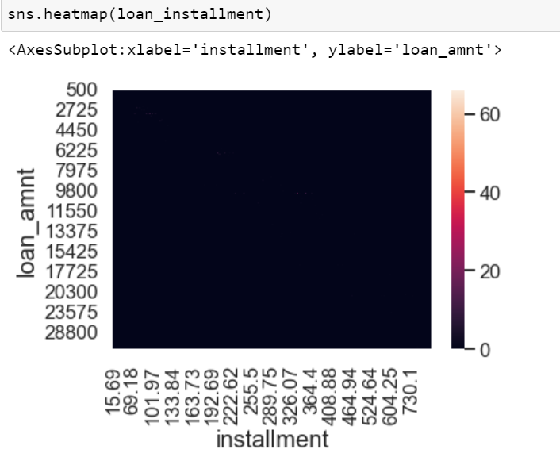
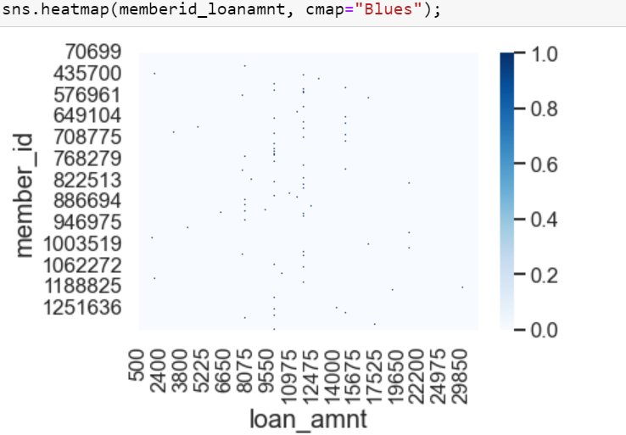
Loan_amnt VS installment heatmap:
A website heat map is an aggregated visualization of user mouse movement, scrolling, clicks, and taps. Heat maps are used by designers, UX specialists, and marketers to discover website usage patterns and make data-informed optimizations to increase conversion rate and revenue.Here loan amount with installment and loan amount with member id correlation is directly proportion which mainsion with that heat map colour variance darkest to lightest colour density. We can find compatibility between 2 varriables also.

Slide 13


Conclusion: - #1 : Applicant in annual income range between 3K and 58K are more defaulters compare to greater annual income - #2 : Applicant between 5k-10k is more defaulter than others - #3 : Applicant with 10 years and more are most defaulters - #4 : Applicant in income group less then 31K are most defaulters - #5 : Applicant verification doesn’t give much concreate outcome on defaulter - #6 : Applicant owns house are less defaulter than others - #7 : Applicant with debt consolidation is the most defaulter whereas renewable energy are least -#8: Some outliners is present in boxplot, Most of the funded imcome is present in 3rd quartile, Median or average of funded amount exists in 3rd quartile -#9: Most of the installment and average median of installments lies in 1st and 2nd quartile. -#10 : loan amount vs or loan amount vs membership correlation is positive . Hence increment and decrement is directly proportional.
Thank You ☺

